Slide 1
Mary Rose Corrigan
City of Dubuque
Health Service Department

Slide 2


Slide 3
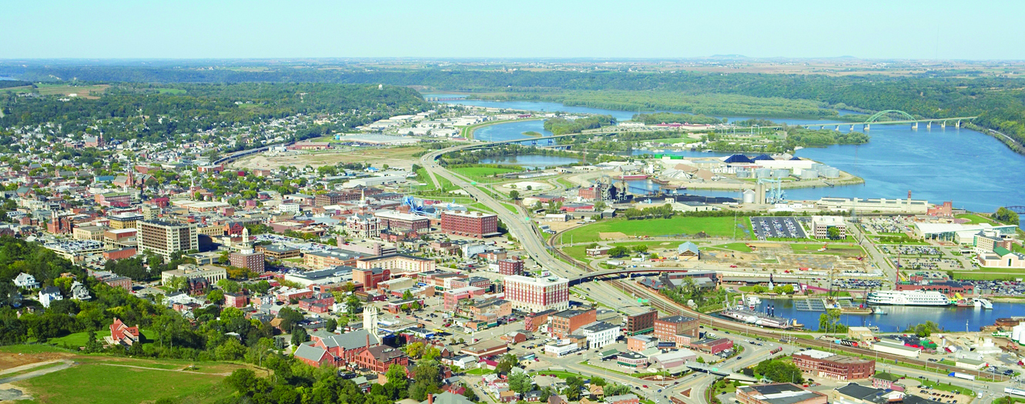
Vision Statement
Dubuque is a viable, livable, and equitable community. We embrace economic prosperity, social/cultural vibrancy and environmental integrity to create a sustainable legacy for generations to come.

Slide 4
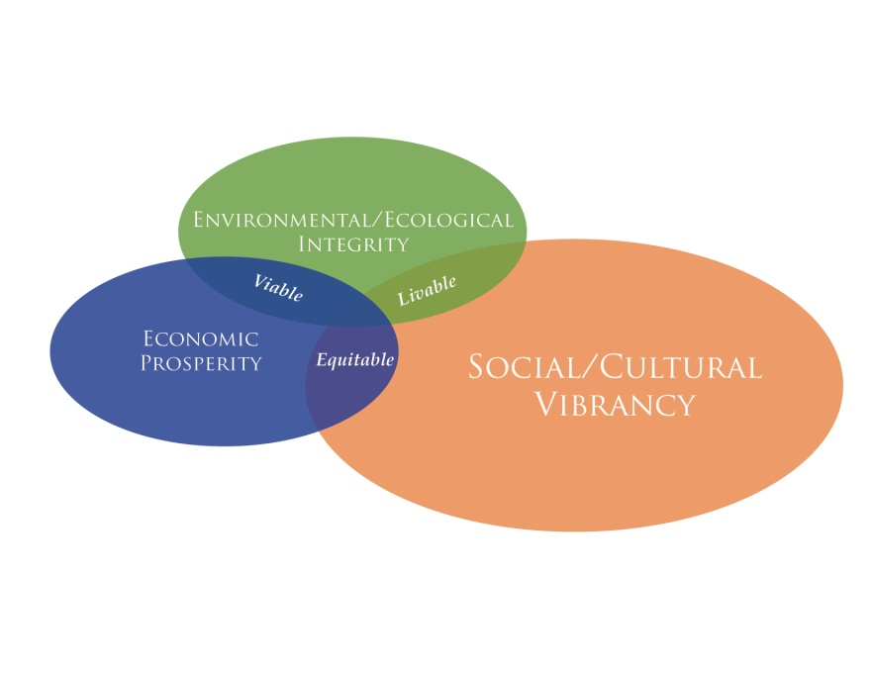




Green Buildings: a productive and healthy built environment.
Healthy Local Foods: the benefits of wholesome food from local producers, distributors, farms, gardens and hunters.
Community Knowledge: education, empowerment and engagement to achieve economic prosperity, environmental integrity and social/cultural vibrancy.
Reasonable Mobility: safe, reasonable and equitable choices to access live, work and play opportunities.

Slide 5
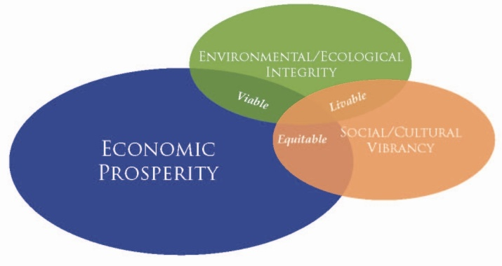




Regional Economy: a diversified regional economy with opportunities for new and green markets, jobs, products and services.
Smart Energy Use: energy conservation and expanded use of renewable energy as a means to save money and protect the environment.
Resource Management: the benefits of reducing, reusing and recycling resources.
Community Design: the built environment of the past, present and future which contributes to its identity, heritage and sense of place.

Slide 6
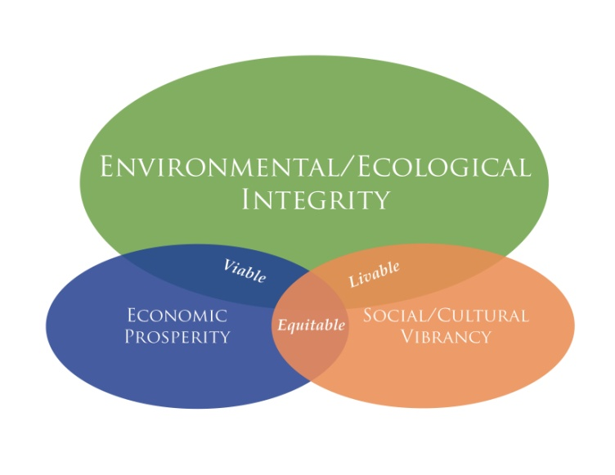



Healthy Air: fresh, clean air, reduced greenhouse gas emissions and minimized health risks.
Clean Water: water as the source of life, seek to preserve and manage it in all forms.
Native Plants & Animals: biodiversity through the preservation, restoration and connection of nature and people.

Slide 7

Energy Assistance —households applying for energy assistance in the form of LIHEAP
.

Slide 8

Smart Resource Use
Theme: Water Use

Slide 9

Energy Star and LEED Certified Buildings
% Non-Residential Green Buildings (2011)
Source: US Green Building Council, EPA

Slide 10
Rental Housing Code Violations

Slide 11

Miles of Bike Paths and Sidewalks to Miles of Roads
Notes:
% of households within ¼ mi of open space

Slide 12
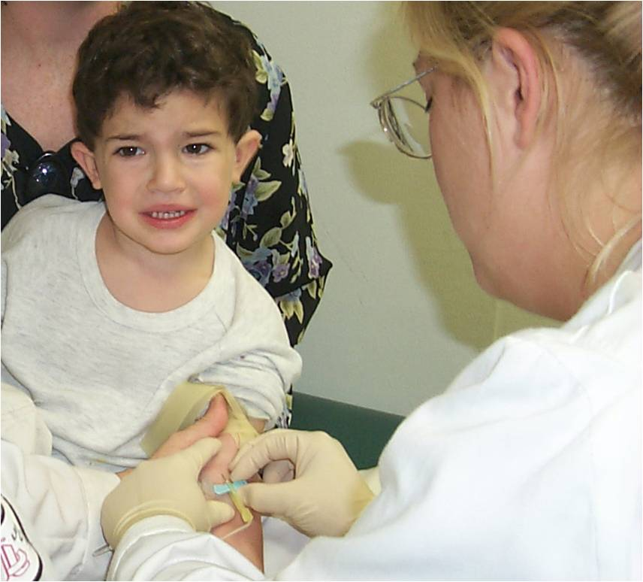
Tested for Lead Poisoning before age 6

Slide 13

Lead Poisoned Children

Slide 14

Healthy Air
EPA Air Quality Index - Percent of monitored days with “Good” air quality

Slide 15
Healthy Air- Radon
Households tested above (>) 4piC/L

Slide 16
Number of ED Visits for Asthma
Notes:
Ave Costs per visit
$544
$681
$724
830
808
$793
2012 $906

Slide 17

Clean Water
EPA Drinking Water Violations 2006-2011

Slide 18

Water
Electricity
Travel
Discards
Health and Wellness
Notes:
Smarter Sustainable Dubuque is a unique public/private partnership between the City of Dubuque and IBM research, and part of the city’s Sustainable Dubuque Initiative. (that aims to meet environmental, economic and social equity needs of residents and future generations.)
Through several initiatives, we’ve been piloting and implementing community wide data collection in a number of areas, such as water and electricity usage, waste disposal, transportation and most recently health and wellness.

Slide 19
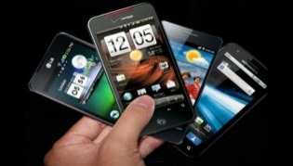
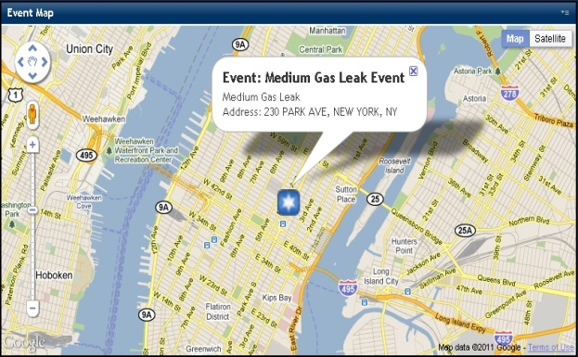
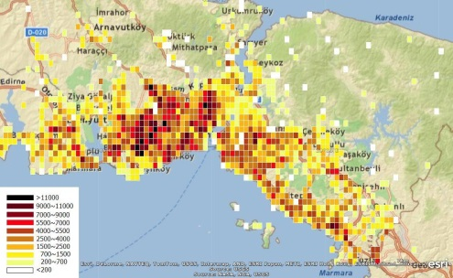

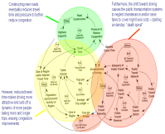
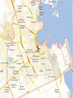




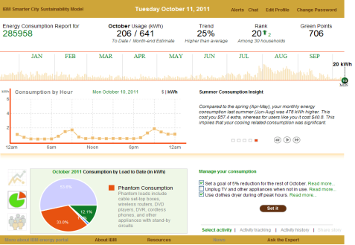
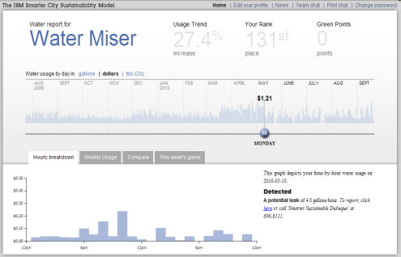







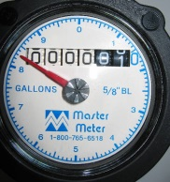
Sustainable Dubuque: Smart Cities Innovator
City in Motion: Making sense of billions of telco events in conjunction with transportation data
Citizen Engagement Platform: Coupling social profiles (Lotus Connections) with Spatial data (IOC) in a 2-way city-citizen communication platform
Single & multi
SpatioTemporal
-
domain
-
Analytics &
Modeling
Information Management
Analytics & Modeling
Dynamic &
Dynamic &
Models
Static Data
Static Data
Impacting
Sensing
Impacting Supply
& Influencing Demand
Influence)
Smart Water Meter Analytics: Analyzing smart meter data for leaks, anomalies, and consumption patterns
Smart Electric Meter Analytics: Analyzing smart meter data for anomalies, and consumption patterns and sharing information

Slide 20

Smarter Sustainable Dubuque
Designed to give people what they
need so they can do what they want
Save money and resources
Improve environment and local economy
Improve Health & Wellness
Reliable information specific to them
Notes:
The idea is to engage citizens by giving them information (based on data they provide to us) to help them make informed decisions about their usage etc, that will result in positive outcomes- either through money savings, improved quality of life or better health outcomes.
Using technology to both engage citizens and gather and analyze data

Slide 21


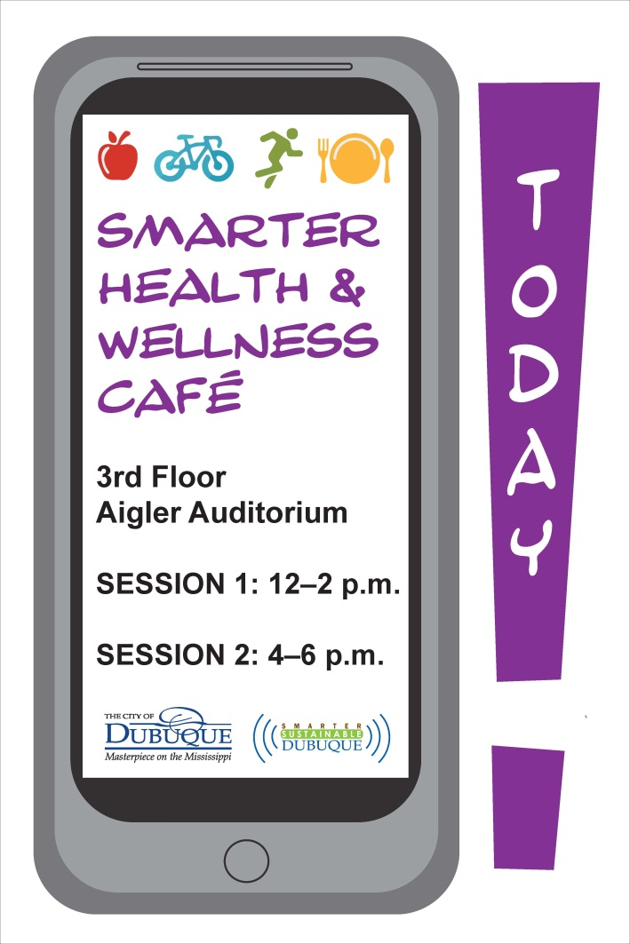
Smarter Health and Wellness Pre-Pilot
70 volunteers
Mobile Apps
  Micro-sensing
  Engagement/Activity Reporting
IBM Intelligent Operations Center (IOC)
Metrics
  Walking and Running Time
  Impact of Engagement
    Messaging
    Event
  Individual Goal Setting
Notes:
Partnership with IBM Research, University of Iowa School of Public Health, City of Dubuque and Greater Dubuque Development Corporation
Context- Communities (social, environmental factors) are often under-represented in efforts to improve population health

Slide 22
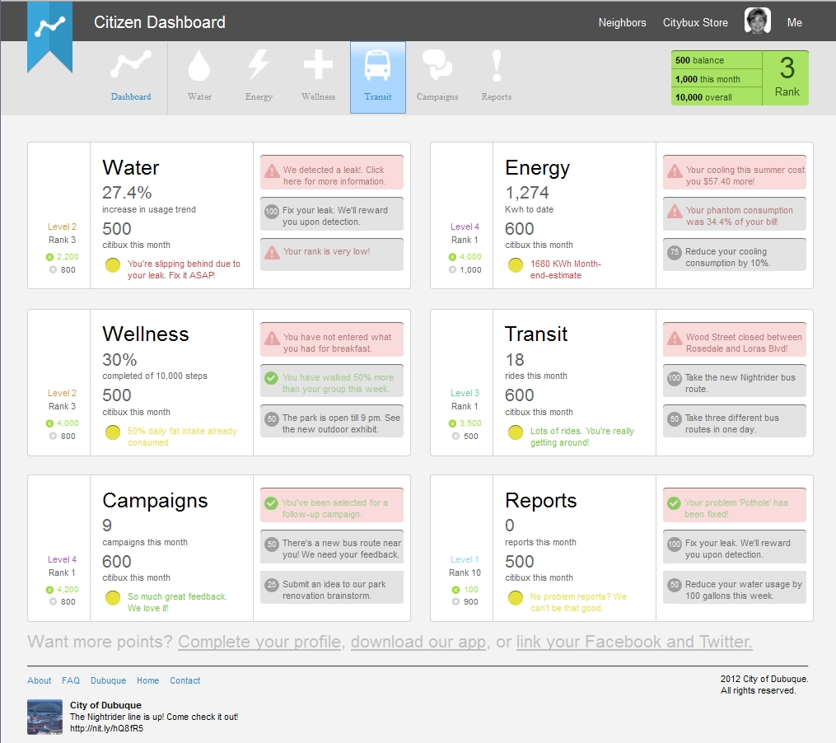
Notes:
Here is an example of the SSD portal with health and Wellness.
As I mentioned previously, The link between income, environment and health is undeniable. Through this “pre-pilot” phase, we hope to develop a model that IBM and the city together can pursue funding for, in order to test on a larger- more community wide scale.
But right now we’re simply testing an application and technology for travel and micro sensing data collection. In late March, you will see a joint development agreement for approval- that will move the pilot to the next phase of development.

Slide 23

What’s next?
Health indicator development
Community input
Data assessment

Slide 24

Health is an outcome of nature, mothers, families, communities and behaviors in a complex, dynamic, and highly interrelated system-of-systems
Media Communications
Education
Transportation
Water
Energy
Medical Care
Health is system-of-systems
Other Govt.
Agencies
Employers
Govt. Public Health
Housing
Housing
Agriculture & Food
Source: IBM IBV analysis based on OECD
Notes:
Catastrophic impact on cots and competitiveness to employers and sustainability to governments and economies is
Heightened receptivity to upstream causes of health and population health
Can we take data from all our smart city initiatives and use it to gain new insights, form hypothesis, link the data to info about people, place time, health care utilization etc through analytics?
The ability to link “resource interactions” between water, electricity, health etc- Can detecting a water leak through a smart meter, result in fewer asthma attacks for a resident since the mold created by the leak was the asthma trigger for that resident? Which results in money saved from fewer health care visits and better health ?

Slide 25



Slide 27
Average Cost/Hazard

Slide 31
GHHI Outcomes

Slide 32
GHHI Outcomes

Slide 33
GHHI Outcomes

Slide 34
City hall annex
1300 Main St dubuque, ia 52001
(563) 589-4181 mcorriga@cityofdubuque.org
Mary Rose Corrigan, Public Health Specialist
City of Dubuque

